Slide 1

Prison Management SUBMITTED TO Dr. S.M. HASAN Mahmud LECTURER AMERICAN INTERNATIONAL UNIVERSITY BANGLADESH

Slide 2
Project Report, Fall 2021-22
Group Members:
Course | Introduction to Database [H] | Group | NOT GIVEN
Student ID | Name | Contribution
21-44681-1 | SABITUL IQRAM | Introduction and Scenario description
21-44664-1 | CHOWDHURY, SAFWAN UDDIN | ER Diagram, normalization
21-44634-1 | SHIKDAR, JAHIDUL ISLAM | Table creation Data insertion,
21-44577-1 | UPOL,MD.DAUD HOSSAIN | Queries and conclusion

Slide 3
INTRODUCTION
The project is about prison management system. This system is made to keep record of all the information of a prison. Online database project is much better than paper records. Paper record can be lost and take too much time to search for a particular information and has no backup. User can access prisoner, visitor, and jailor’s information very easily with the help of the prison management system.

Slide 4
SCENARIO DECRIPTION:
In a prison management system, a jailor can permit many visitors. A visitor can be permitted by a jailor. A jailor is identified by jailor id (J_ID), Jailor age (J_AGE) and jailor name (J_NAME) where jailor id (J_ID) is “Primary key”. A jailor becomes visitors and visit prisoner. System stores visitor’s name (V_NAME), visitor’s gender (V_GENDER), visitor’s id (V_ID) here (V_ID) is a “Primary key”, visitor’s number (V_PHONE NUMBER), visitor’s NID number(V_NID), relation with prisoner (RELATION), prisoner ID (P_ID) here (P_ID) is a “Foreign key” and jailor ID (J_ID) here jailor ID (J_ID) is a “Foreign key” . A visitor may visit many prisoners. A prisoner can be visited by many visitors. A prisoner is identified by the prisoner’s name (P_NAME), prisoner id (P_ID) here (P_ID) is a “Primary key”, prisoner’s gender (GENDER), prisoner’s address (ADDRESS), prisoner’s entry date (ENTRY DATE), prisoner’s face reorganization (FACE RECOGNIZE), prisoner’s date of birth (DOB), prisoner’s age (AGE), prisoner’s eye scan (EYE SCAN), and prisoner’s fingerprint (FINGER PRINT). A prisoner has exactly one cell. A cell may have many prisoners. Cell is identified by cell name (CELL NAME), cell number (CELL NUMBER), cell capacity (CAPACITY) and prisoner’s Id (P_ID) here prisoner’s Id (P_ID) is a “Foreign key”. A prisoner may commit many crimes. A crime can be committed by many prisoners. Crime is identified by crime count (CRIME COUNT), remand (REMAND), date in (DATE IN), crime id (CRIME ID) here crime id (CRIME ID) is a “Primary key”, crime case Id (CASE ID) here crime case Id (CASE ID) is a “Foreign key” and prisoner’s Id (P_ID) here prisoner’s Id (P_ID) is a “Foreign key”. Crime has case and cases are identified by case id (CASE ID) here case Id (CASE ID) is a “Primary key” and case type (CASE TYPE). And there is punishment for every prisoner. A prisoner can be punished. Punishment is identified with high punishment (PMENT_HIGH), low punishment (PMENT_LOW) and punishment name (PMENT_NAME).

Slide 5
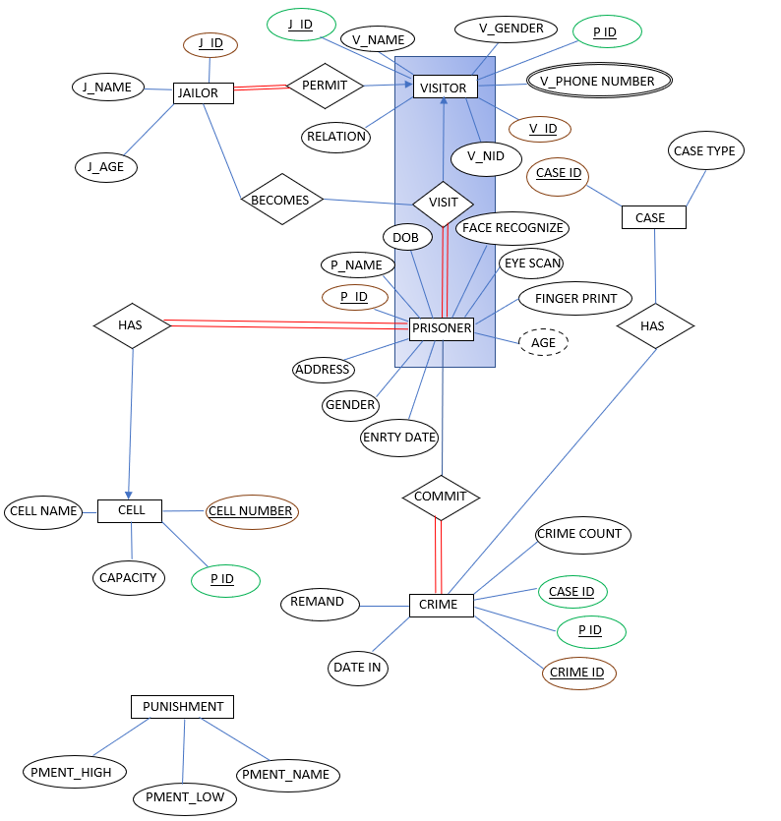
ER DIAGRAM:

Slide 6
ER DIAGRAM IMPROVEMENTS:
Visualization improvements were done as the earlier one was not clearly visible.
Some attribute was added and some was removed as necessary.
Aggregation was missing in the previous ER diagram. Aggregation was added between jailor visitor and prisoner.
Participation was not identified in the mid-term ER diagram. So, the participation was identified.
New Entity PUNISHMENT was added with three attributes.
FINGERPRINT was made single valued attribute from multi-valued attribute to make it simple.
Cardinality was shown properly.
Some foreign key was introduced.
At last separate color was added to make it easier to understand. As like brown for primary key, red for total participation and green for foreign keys.

Slide 7
NORMALIZATION
JAILOR: This entity has no transitive dependency and functional dependency. So, it is already in 3NF
VISITOR: VISITOR table has phone number which is multivalued attribute. This can be separated in two by phone number 1 and phone number 2 and make this attribute independent. Other attributes of this table are already independent. So, it is also in 3NF.
PRISONER: This table has no transitive or functional dependencies and therefore it is already in 3NF.
CRIME: All the attribute of this table can be identified uniquely with the primary key.
CASE: Already in 3NF.
CELL: No functional and transitive dependency.
PUNISHMENT: Already in 3NF.

Slide 8
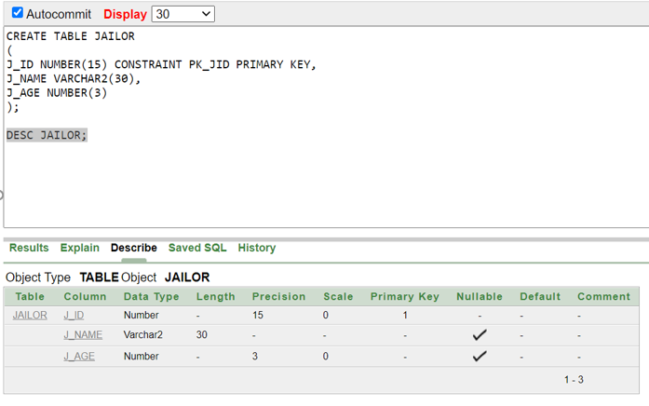
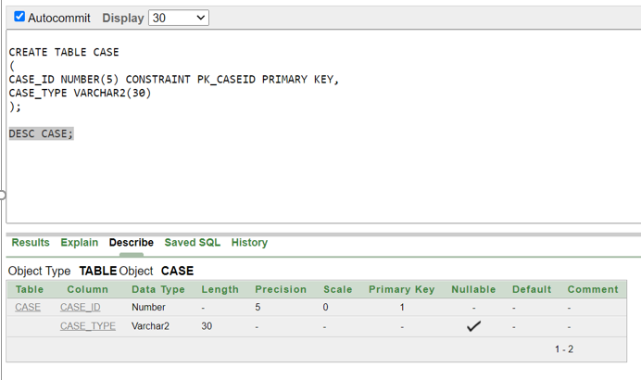
TABLE OF JAILOR
TABLE OF CASE

Slide 9
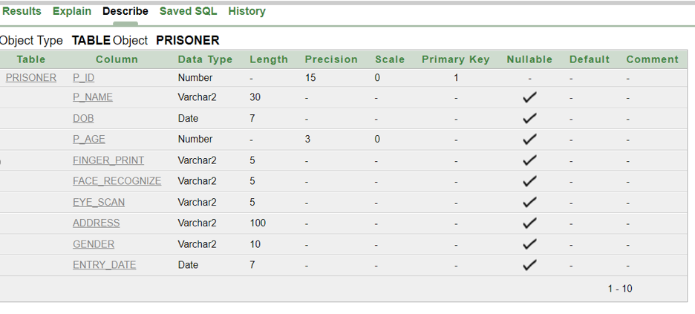
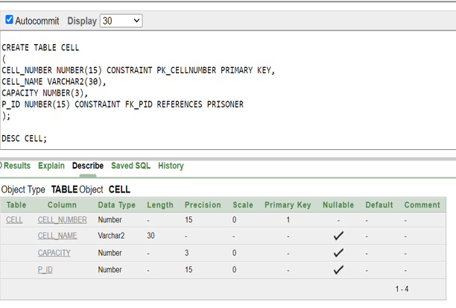
TABLE OF PRISONER
TABLE OF CELL

Slide 10
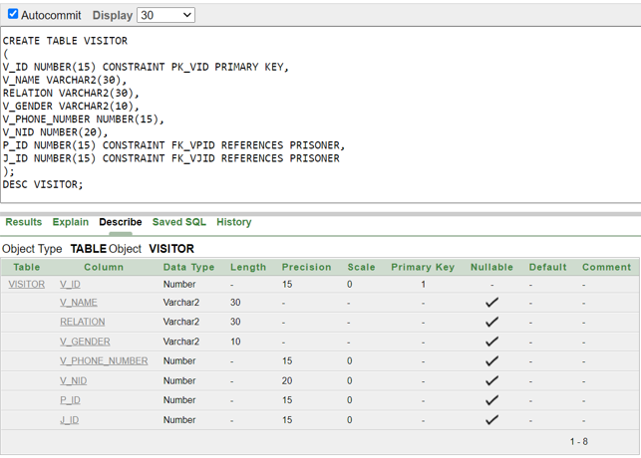
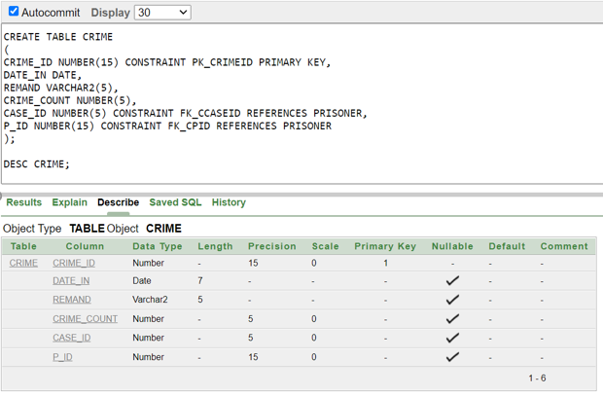
TABLE OF VISITOR
TABLE OF CRIME

Slide 11
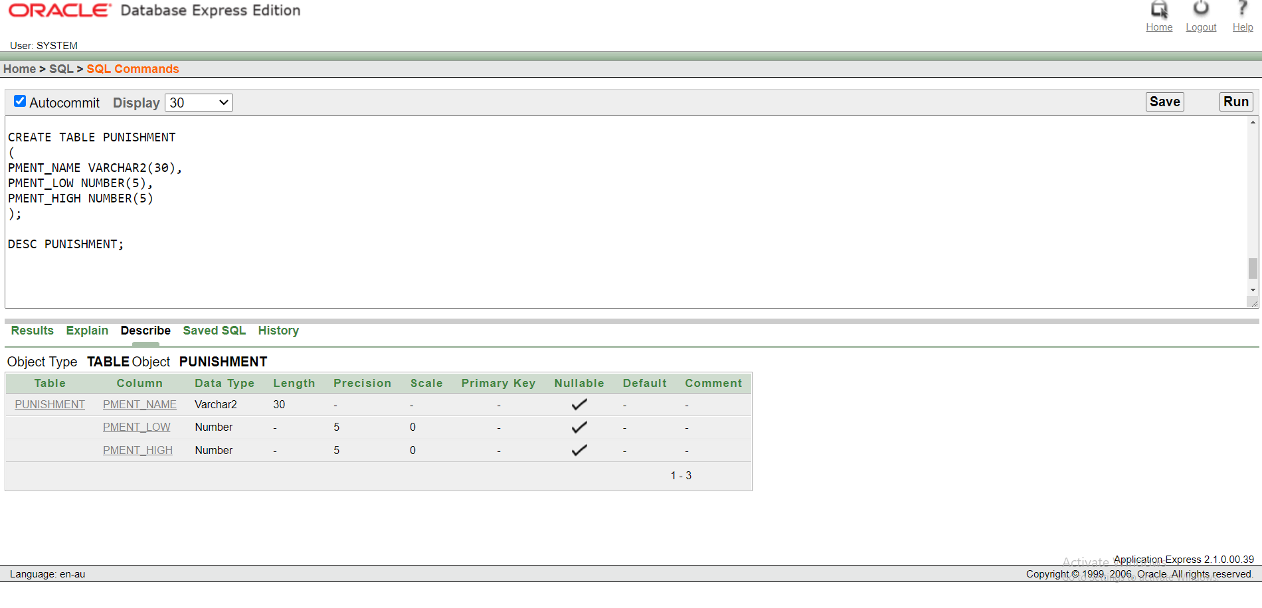
TABLE OF PUNISHMENT

Slide 12
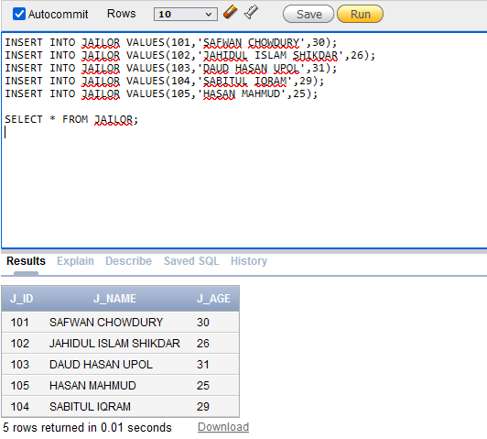
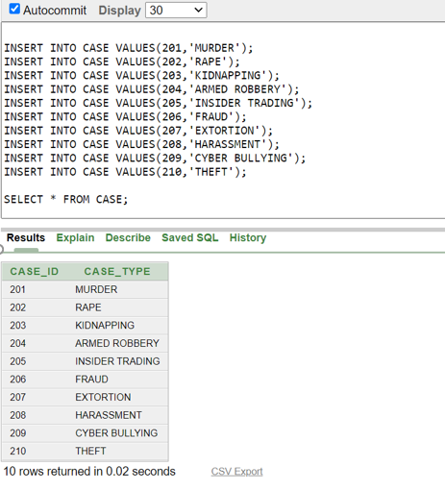
DATA INSERTION:
INSERT VALUE INTO JAILOR
INSERT VALUE INTO CASE

Slide 13
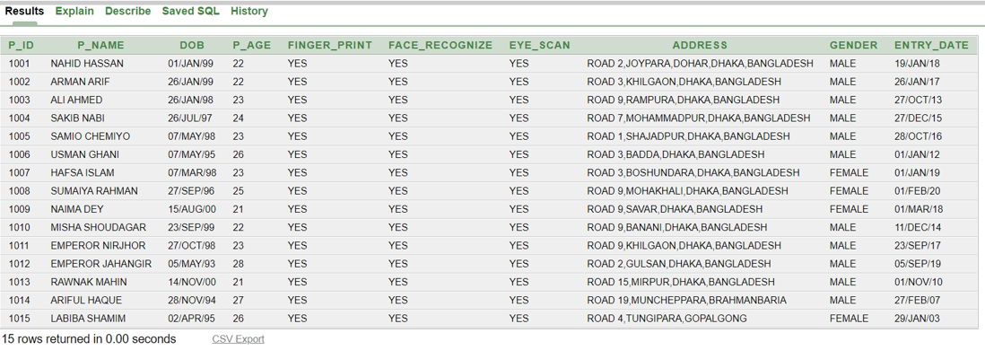
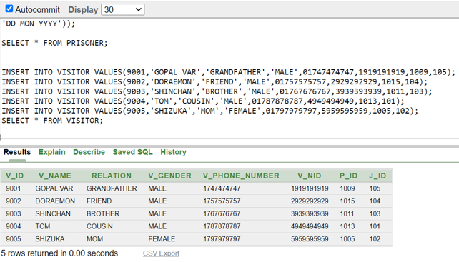
INSERT INTO PRISONER
INSERT INTO VISITOR

Slide 14
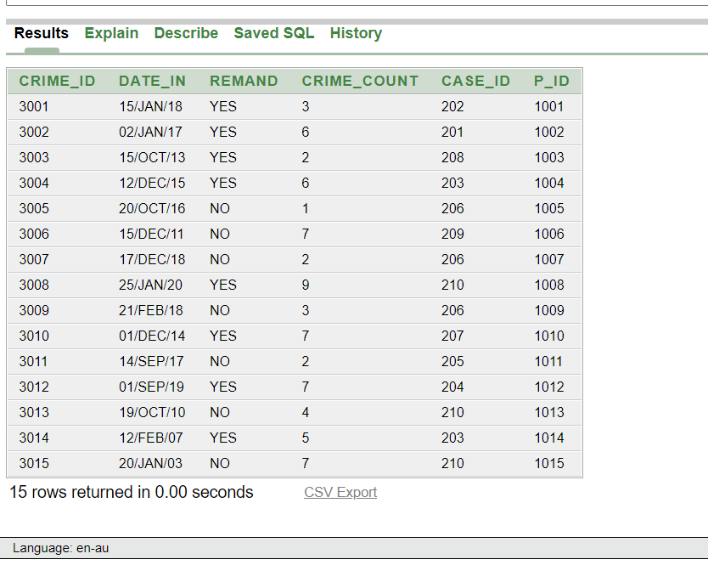
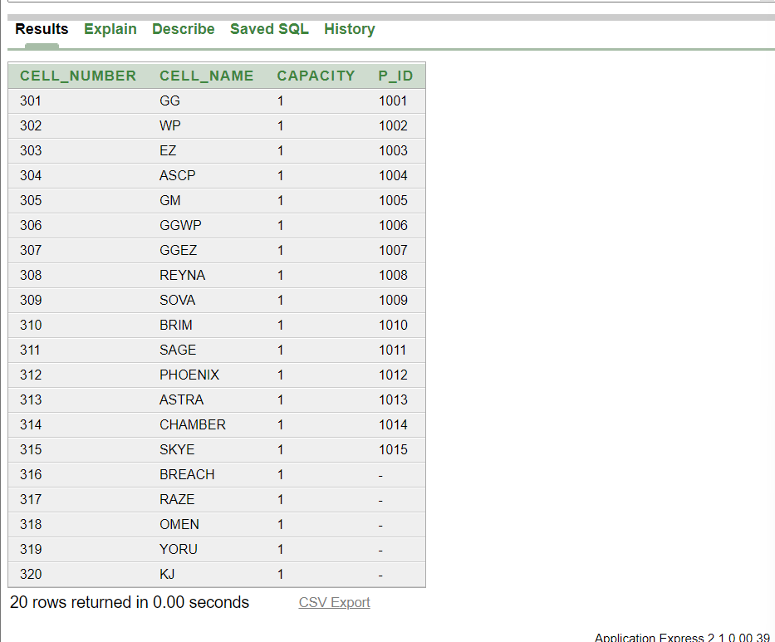
INSERT VALUE INTO CRIME
INSERT VALUE INTO CELL

Slide 15
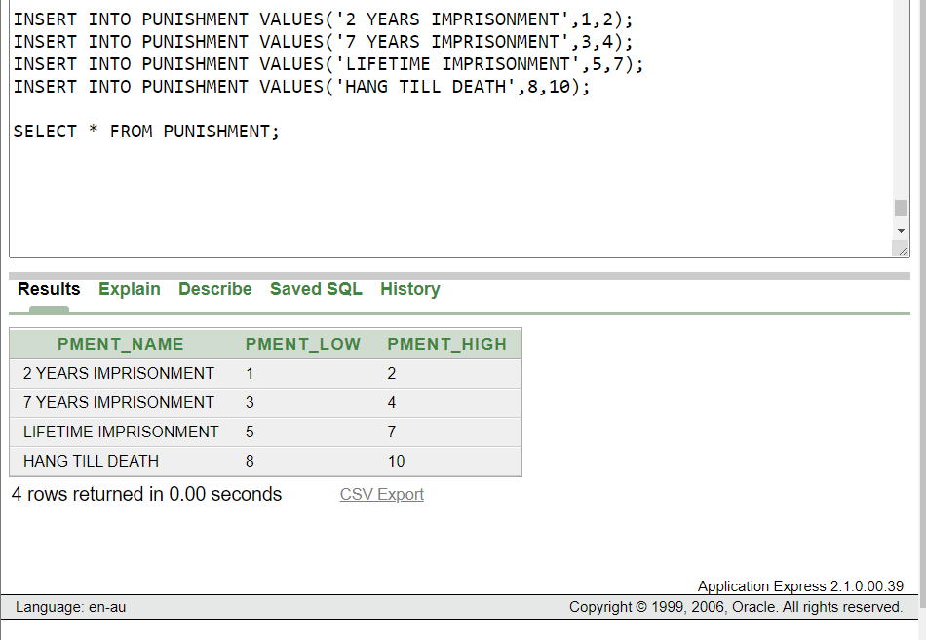
INSERT VALUE INTO PUNISHMENT

Slide 16
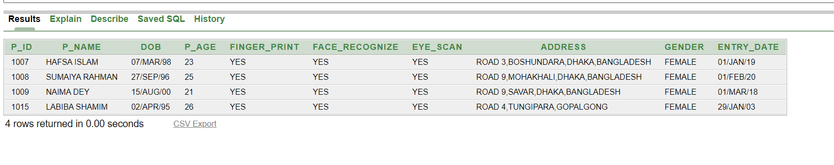
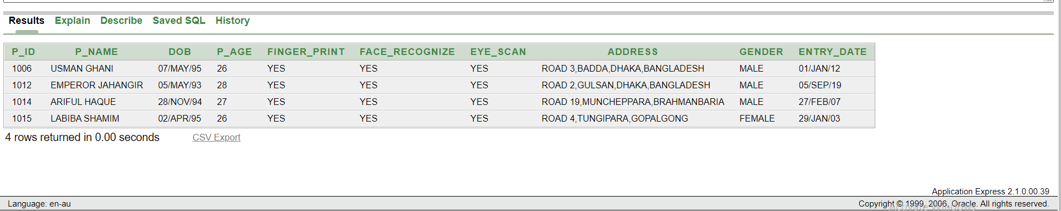
QUERIES:
2 simple queries with simple condition:
QUESTION:
Show all the female prisoners.
SELECT * FROM PRISONER WHERE GENDER = 'FEMALE';
Show all the prisoner who are more than 25 years old.
SELECT * FROM PRISONER WHERE P_AGE > 25;

Slide 17
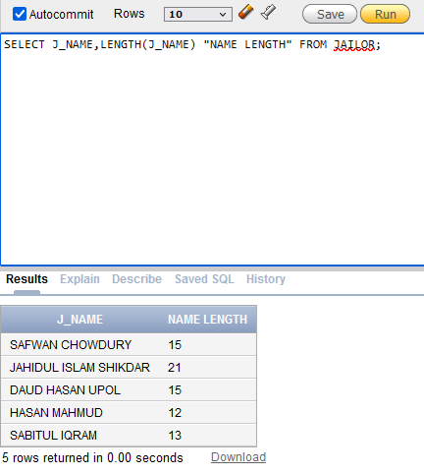
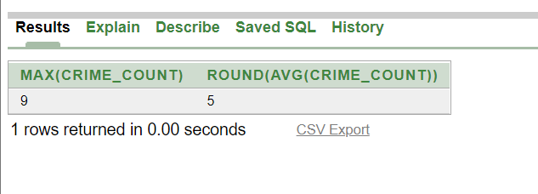
1 single row function query:
QUESTION:
FIND EVERY JAILORS NAME LENGTH
SELECT J_NAME,LENGTH(J_NAME) "NAME LENGTH" FROM JAILOR;
1 multiple row function query:
QUESTION:
FIND THE MAXIMUM AND MEAN CRIME OF ALL PRISONERS
SELECT MAX(CRIME_COUNT),ROUND(AVG(CRIME_COUNT)) FROM CRIME;

Slide 18
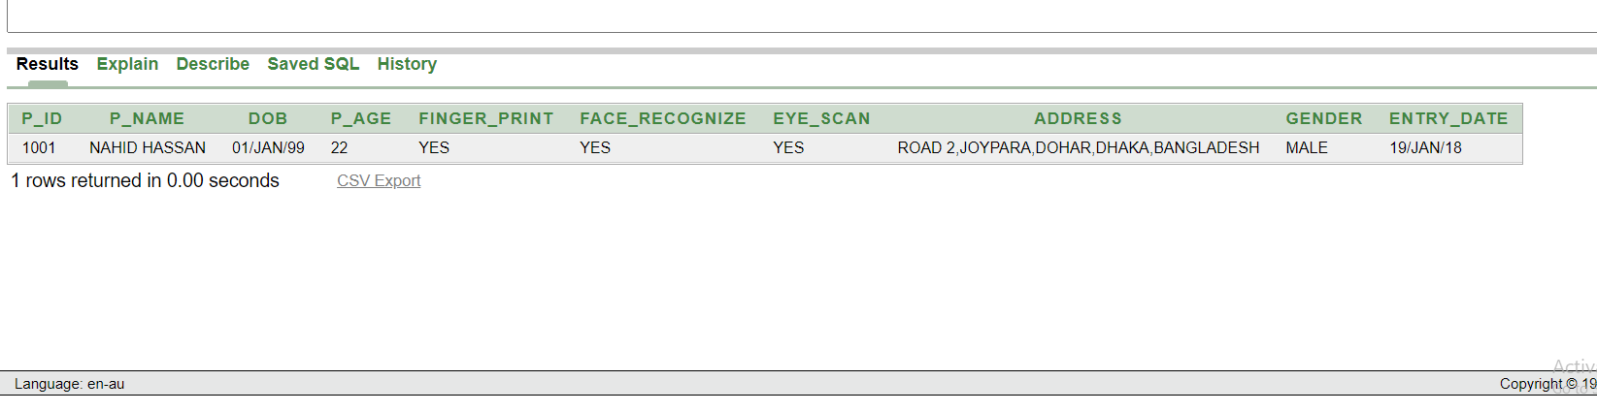
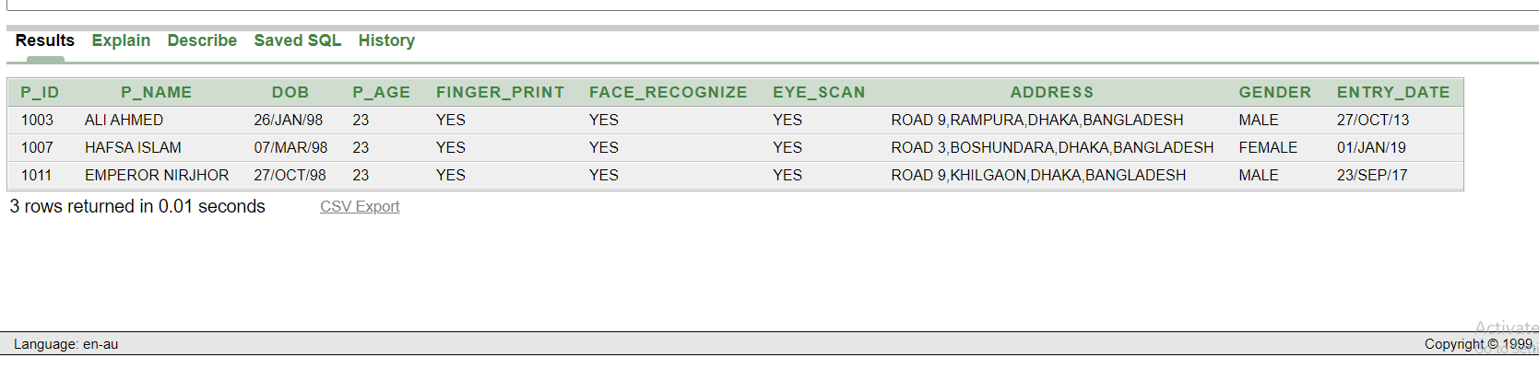
2 SINGLE ROW SUB QUERY:
QUESTION:
SHOW THE PRISONER INFORMATION WHO’S
CELL
NUMBER IS 301
SELECT * FROM PRISONER WHERE P_ID =
(SELECT P_ID
FROM CELL WHERE CELL_NUMBER = 301);
1 MULTI ROW SUB QUERY:
QUESTION:
SHOW ALL THE PRISONERS WHO HAVE DONE 2 CRIMES
SELECT * FROM PRISONER WHERE P_ID IN (SELECT P_ID FROM CRIME WHERE CRIME_COUNT = 2);

Slide 19
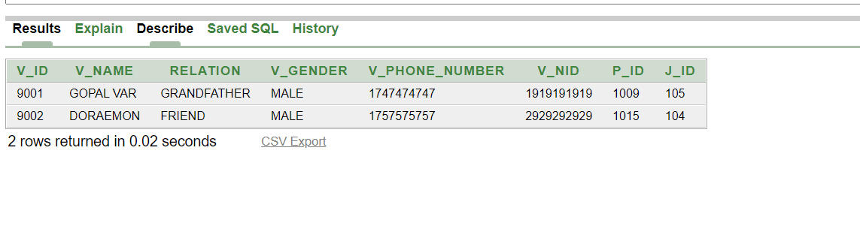
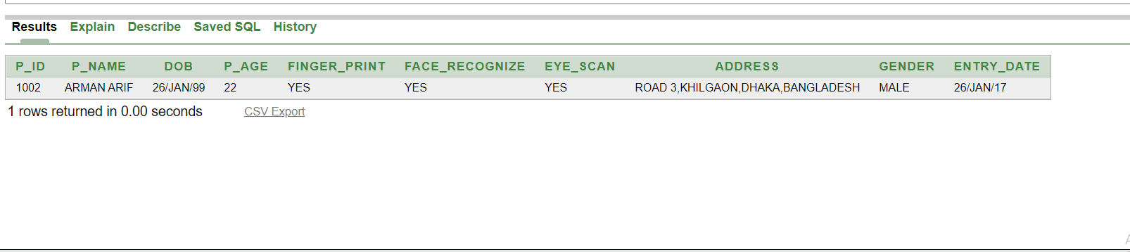
2 COMPLEX SUB QUERY:
QUESTION:
SHOW ALL THE VISITOR INFORMATION WHO IS GOING TO VISIT FEMALE PRISONERS WHO IS NOT UNDER REMAND
SELECT * FROM VISITOR WHERE P_ID IN (SELECT P_ID FROM PRISONER WHERE P_ID IN (SELECT P_ID FROM CRIME WHERE REMAND = 'NO') AND GENDER = 'FEMALE');
QUESTION:
SHOW ALL THE PRISONER INFORMATION WHO ARE CHARGED FOR MURDER.
SELECT * FROM PRISONER WHERE P_ID IN (SELECT P_ID FROM CRIME WHERE CASE_ID = (SELECT CASE_ID FROM CASE WHERE CASE_TYPE = 'MURDER'));

Slide 20
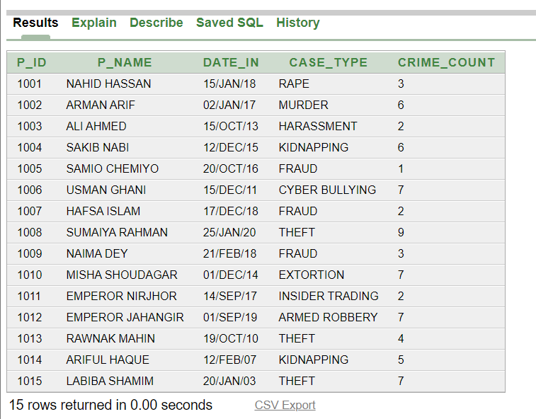
JOINING QUERIES:
EQUIJOIN QUERY:
QUESTION:
SHOW THE INFORMATION OF PRISONER ID, PRISONER NAME, DATE IN, CASE TYPE CRIME COUNT USING EQUIJOIN.
SELECT P.P_ID,P.P_NAME,C.DATE_IN,CASE.CASE_TYPE,C.CRIME_COUNT FROM PRISONER P, CRIME C,CASE WHERE CASE.CASE_ID = C.CASE_ID AND C.P_ID = P.P_ID;

Slide 21
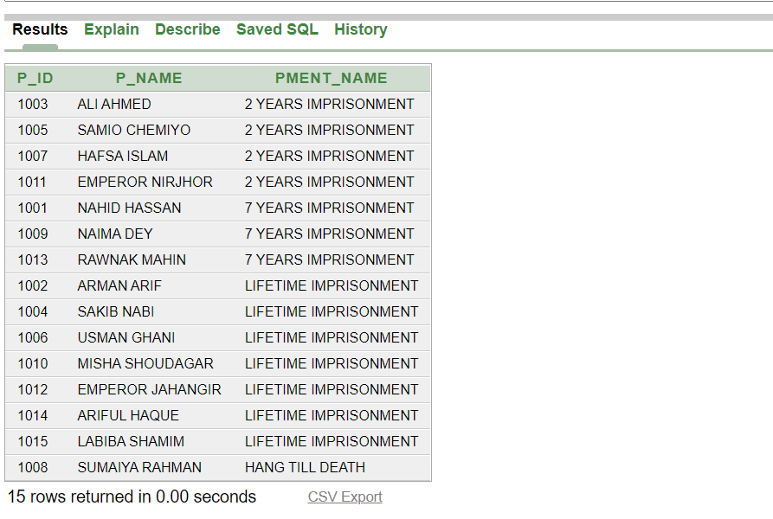
NON-EQUIJOIN QUERY:
QUESTION:
SHOW THE PUNISHMENT NAME OF ALL THE PRISONERS USING NON-EQUIJOIN
SELECT P.P_ID,P.P_NAME,PT.PMENT_NAME FROM PUNISHMENT PT, CRIME C, PRISONER P WHERE C.CRIME_COUNT BETWEEN PT.PMENT_LOW AND PT.PMENT_HIGH AND P.P_ID = C.P_ID;

Slide 22
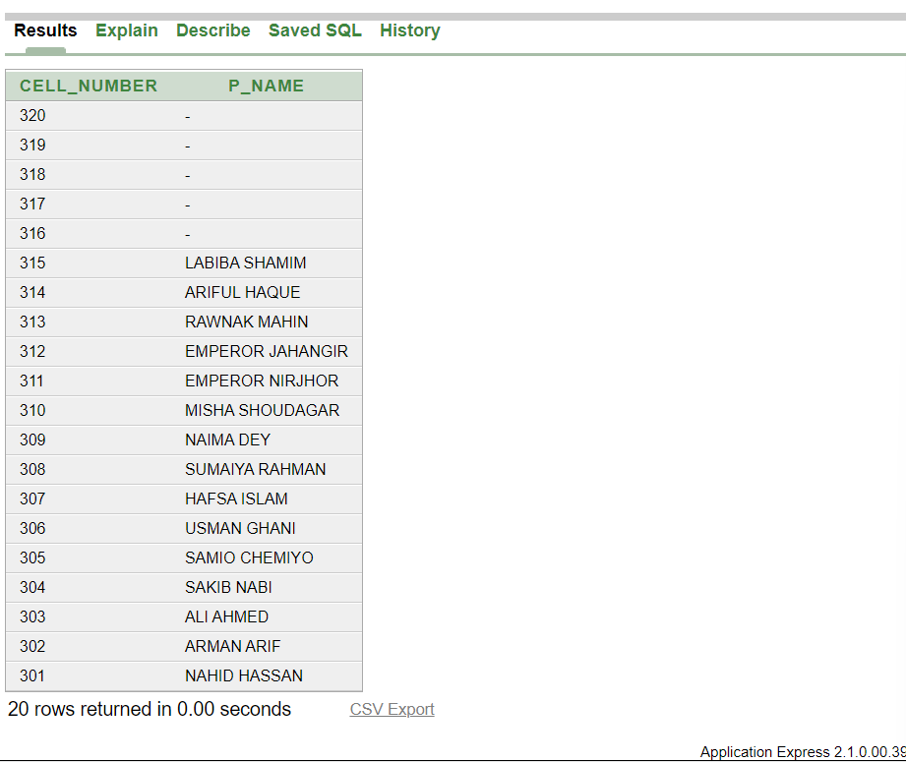
LEFT OUTER JOIN QUERY:
QUESTION:
SHOW ALL THE CELL AND PRISONER FROM CELL USING LEFT OUTER JOIN
SELECT C.CELL_NUMBER,P.P_NAME FROM CELL C LEFT OUTER JOIN PRISONER P ON (C.P_ID = P.P_ID) ORDER BY CELL_NUMBER DESC;

Slide 23
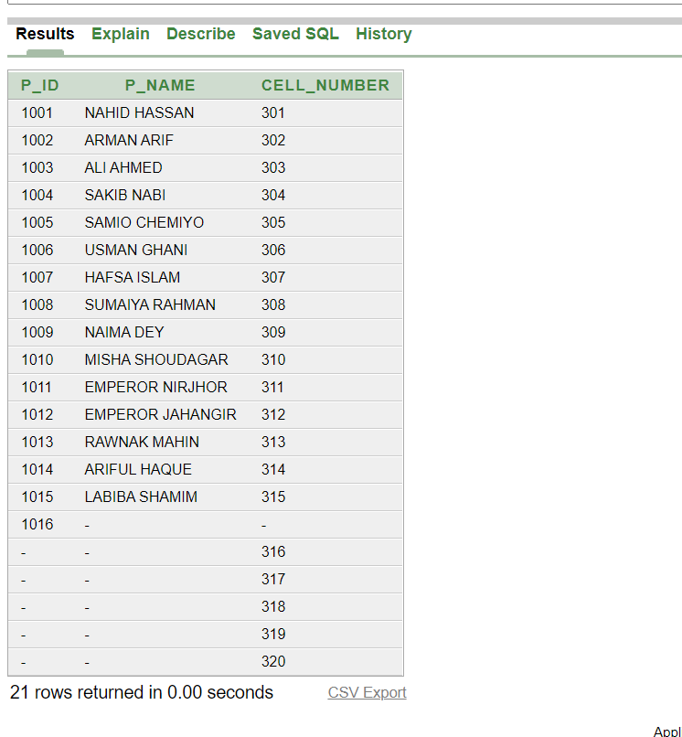
FULL OUTER JOIN QUERY:
QUESTION:
SHOW ALL INFORMATION OF PRISONER ID ,PRISONER NAME AND CELL NUMBER FROM PRISONER AND CELL.
SELECT P.P_ID,P.P_NAME,C.CELL_NUMBER FROM PRISONER P FULL OUTER JOIN CELL C ON(P.P_ID = C.P_ID);

Slide 24
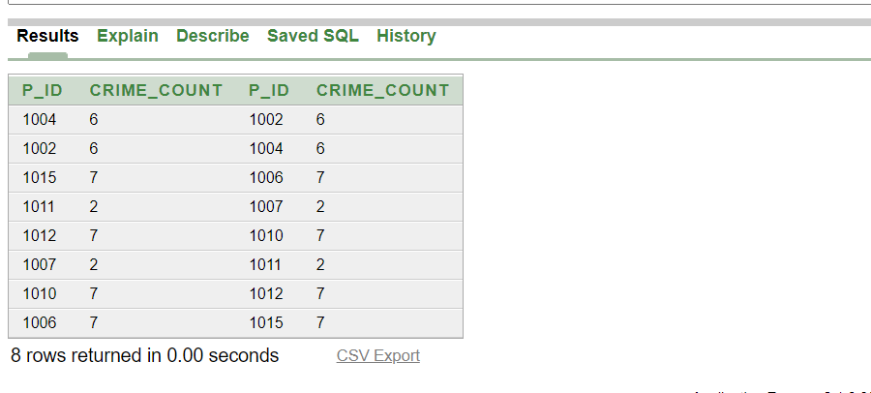
SELF JOIN QUERY:
QUESTION:
SHOW PRISONER ID AND CRIME COUNT WHO HAS SAME NUMBER OF CRIME.
SELECT A.P_ID,A.CRIME_COUNT,B.P_ID,B.CRIME_COUNT FROM CRIME A,CRIME B WHERE A.P_ID <> B.P_ID AND A.CRIME_COUNT = B.CRIME_COUNT AND A.REMAND = B.REMAND;

Slide 25
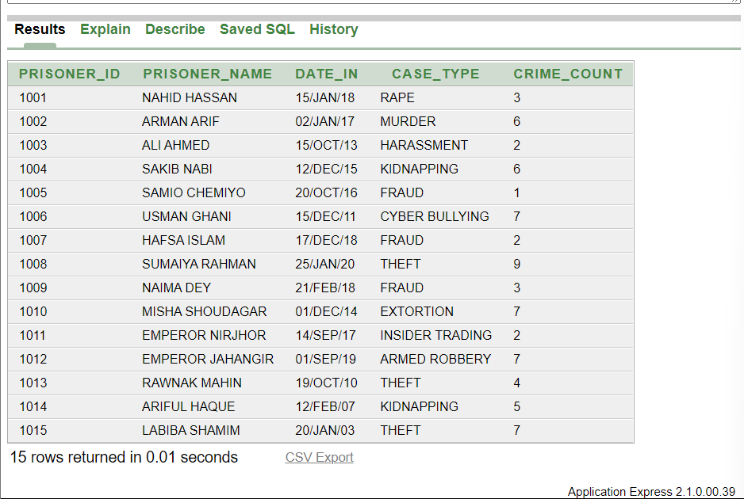
VIEW:
QUESTION:
SHOW PRISONER ID , PRISONER NAME , DATE IN, CASE TYPE , CRIME COUNT BY CREATING A VIEW.
CREATE OR REPLACE VIEW PRISONERVIEW (PRISONER_ID, PRISONER_NAME, DATE_IN, CASE_TYPE,CRIME_COUNT) AS SELECT P.P_ID,P.P_NAME,C.DATE_IN,CASE.CASE_TYPE,C.CRIME_COUNT FROM PRISONER P, CRIME C,CASE WHERE CASE.CASE_ID = C.CASE_ID AND C.P_ID = P.P_ID;
SELECT * FROM PRISONERVIEW;

Slide 26
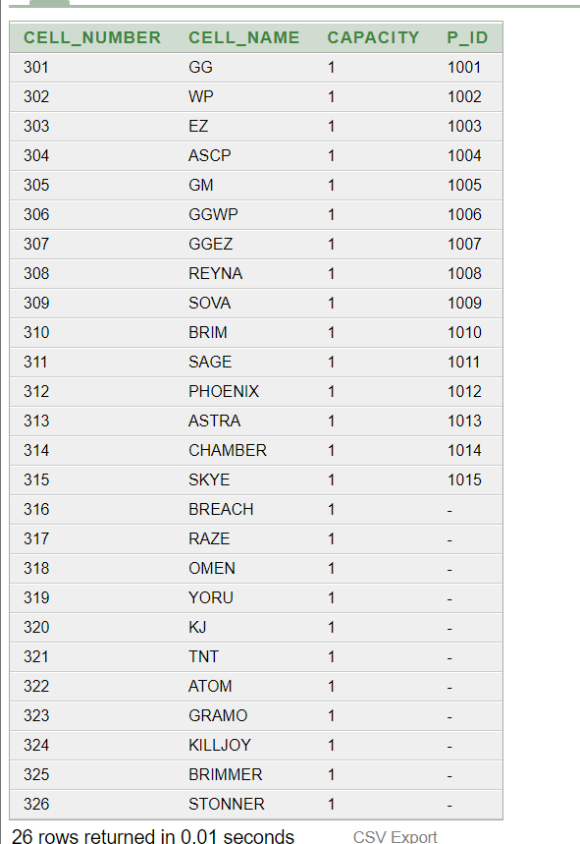
SEQUENCE:
CREATE SEQUENCE CELLSEQUENCE
MINVALUE 321
MAXVALUE 399
START WITH 321
NOCACHE
NOCYCLE
INCREMENT BY 1;
INSERT INTO CELL VALUES(CELLSEQUENCE.NEXTVAL,'TNT',1,NULL);
INSERT INTO CELL VALUES(CELLSEQUENCE.NEXTVAL,'ATOM',1,NULL);
INSERT INTO CELL VALUES(CELLSEQUENCE.NEXTVAL,'GRAMO',1,NULL);
INSERT INTO CELL VALUES(CELLSEQUENCE.NEXTVAL,'KILLJOY',1,NULL);
INSERT INTO CELL VALUES(CELLSEQUENCE.NEXTVAL,'BRIMMER',1,NULL);
INSERT INTO CELL VALUES(CELLSEQUENCE.NEXTVAL,'STONNER',1,NULL);
SELECT * FROM CELL;

Slide 27
CONCLUSION:
This project is just a framework with many more potential attachments to it. As this an introductory course of database, our skill level is not good enough to build a more accurate system to manage a huge facility like prison. We think when we will gain more knowledge about advance database, we can apply more tables, security and more complexity added to the system. Suppose we want to add more different kind of sections in the prison with more titled officers, constables, and so on. We can also add solitary unit, isolation unit, medical ward, doctor’s office, entertainment room and more. This prison management system is a unique and diverse system which can be upgraded in many ways and by making it more complex and diverse. In future, we can develop this project with our efficiency.

